Slide 1

Prepared by group 8
IOT based In-Cabin Air Quality Monitoring System
BY
Hima Bindu P -2022BCY0062
Anusha V -2022BCY0014
Nandini D -2022BCY0038
Sree Divya N -2022BCY0053
Mounika S -2022BCY0060
Guided by
Dr. G Bhanu Chander Sir

Slide 2
Introduction
Development of a prototype air quality monitoring system for vehicle cabins.
Utilizes various sensors (air quality, temperature, humidity, gas) for data collection.
Connected to an IoT platform (Blynk App) for real-time data visualization.
Follows a prototyping approach with stages: communication, planning, modeling, construction, and testing.
Ensures data integrity through HMAC SHA256 authentication between sensors and middleware (Python server) on a laptop.
Authenticated data is sent to the Blynk App for monitoring.
System effectively detects and monitors air quality in vehicle cabins.

Slide 3
Significance
Addresses the often-overlooked issue of air quality inside vehicle cabins, which can negatively affect passengers' health.
Develops an IoT-based monitoring system for real-time tracking of harmful pollutants inside vehicles.
Enables users to monitor their environment and take necessary actions based on air quality data.
Ensures secure data transmission through the use of HMAC SHA256 authentication, enhancing system reliability.
Contributes to greater awareness of vehicle air quality and promotes healthier driving conditions.

Slide 4
Literature Review
Air Quality Monitoring System
Authors: Anitha N, Anne Caroline S ,Shalini P, Trisha V (14-15 December 2023)
The proposed system improves indoor air quality monitoring using Arduino UNO,
Optical dust, and MQ-135 sensors to calculate AQI, displaying results on an LCD and
triggering alerts with blinking LEDs when harmful air levels exceed safe limits (>400
ppm).
https://ieeexplore.ieee.org/document/10448553
Application of MQ-Sensors to Indoor Air Quality Monitoring in Lab based on IoT
Authors: Hussein J. Khadim, Faik K. Obaed, Ziad T. Abd Ali (01-02 November 2021)
This research paper presents a web-based indoor air quality monitoring system
(IAQML) for laboratory environments, utilizing MQ-sensors and Arduino to track and
display pollutant levels.
https://ieeexplore.ieee.org/document/9615333

Slide 5
Air Quality Monitoring and Detection System in Vehicle Cabin Based on Internet of Things
Authors: Jacquline Waworundeng, Priana Sari Adrian (25-26 October 2021)
This research develops a prototype air quality monitoring system for vehicle cabins, utilizing
sensors (air quality, temperature, humidity, carbon monoxide, dust), a microcontroller, and
IoT platforms (Blynk and ThingSpeak) to provide real-time monitoring and alerts, effectively
raising awareness of in-vehicle air quality.
https://ieeexplore.ieee.org/document/9649627
Secure protocol for wireless sensor network
Authors: Vinay Kumar Pandey, Gaurav Gupta,Sorabh Gupta (11-13 March 2015)
This scheme proposes a secure wireless sensor network protocol with event-driven cluster
formation for energy efficiency, using a level-based hierarchical approach. It incorporates
lightweight security mechanisms like nested HMAC, ECDH key exchange, and Blowfish
symmetric encryption.
https://ieeexplore.ieee.org/document/7100414

Slide 6
Motivation
Real-Time Monitoring in Dynamic Environments:Designed for vehicle cabins, the system continuously tracks air quality in real-time, unlike most existing static indoor monitoring solutions.
IoT-Based Framework: Integrated with IoT platforms for live data transmission and dashboard visualization on mobile devices, enabling immediate awareness and alerts.
Enhanced Data Security: Utilizes HMAC to ensure the integrity and authenticity of air quality data, preventing tampering during transmission.
Comprehensive Monitoring: Captures a wide range of pollutants and environmental factors to promote both health and eco-friendly driving practices.

Slide 7
Problem Statement
In-vehicle air quality is often overlooked, with harmful gases and pollutants circulating without passengers' awareness.
These contaminants can negatively impact passengers' health, especially during long travels.
Most vehicles lack real-time air quality monitoring systems for tracking air quality inside cabins.
This project aims to develop a prototype system that continuously monitors air quality within the vehicle.
Provides real-time data via a smartphone app, allowing passengers to monitor the air they breathe.
Integrates sensors for air quality, temperature, humidity, and gas levels, along with a microcontroller for data processing.
Uses HMAC SHA-256 authentication for secure data exchange.
A reliable tool for real-time air quality monitoring, addressing health concerns and promoting awareness.

Slide 8
Architecture
MQ135 gas sensor is used to monitor air quality by detecting various pollutants in real-time, and a DHT22 sensor measures temperature and humidity.
The sensors are connected to an ESP32 board which processes the data and perform hashing and then sends it to the server via the Wi-Fi module.
The Blynk app displays the temperature,humidity, and an overall air quality level, which is based on the combined readings from the gas sensors.
Individual gas concentrations are not displayed separately on the Blynk app.
Data is also shown on an LCD display, which provides real-time readings of overall air quality, temperature, and humidity.
The system enables continuous monitoring of air quality, temperature, and humidity, where higher readings indicate worse air quality.

Slide 9
Architecture
Security Enhancement:
HMAC SHA256 Authentication: Secures communication between the ESP32 sensors and a middleware server.
Data Integrity: Ensures that the sensor data is authenticated and tamper-proof before being transmitted to the Blynk app.
Secure Transmission: Authenticated and encrypted data is transferred over Wi-Fi to prevent unauthorized access or tampering.
Outcome:
The system continuously monitors air quality, temperature, and humidity, with secured real-time data transmitted to the Blynk app for remote monitoring.

Slide 10
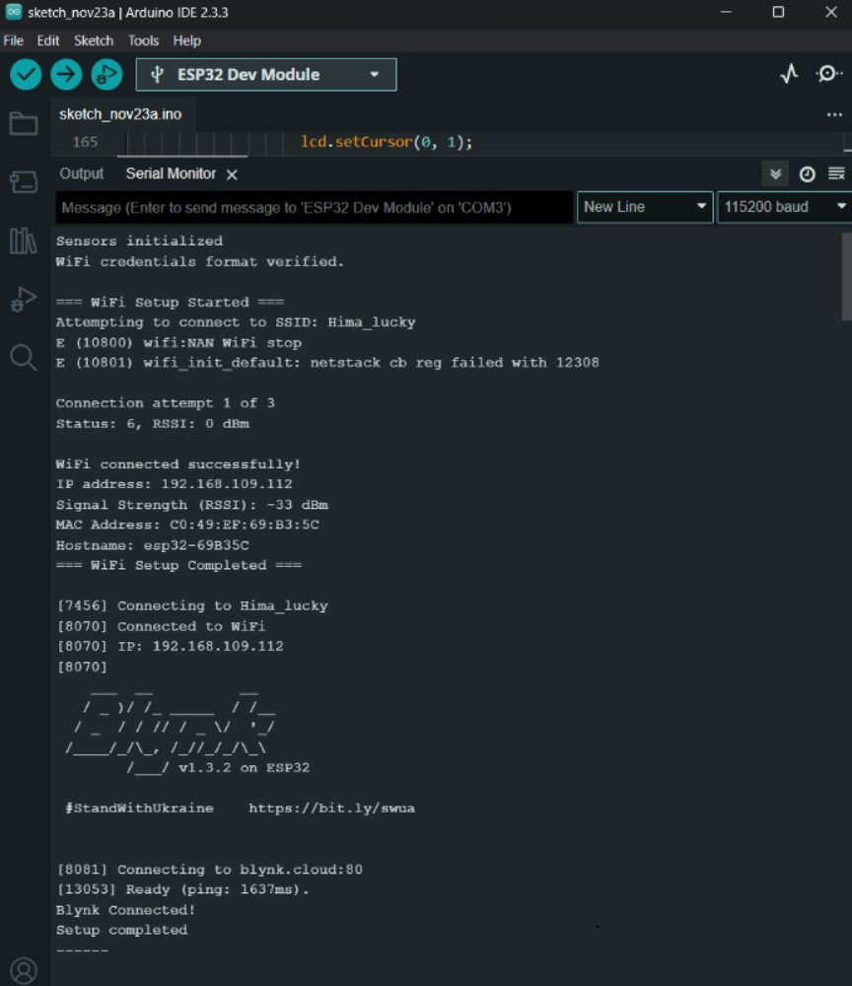
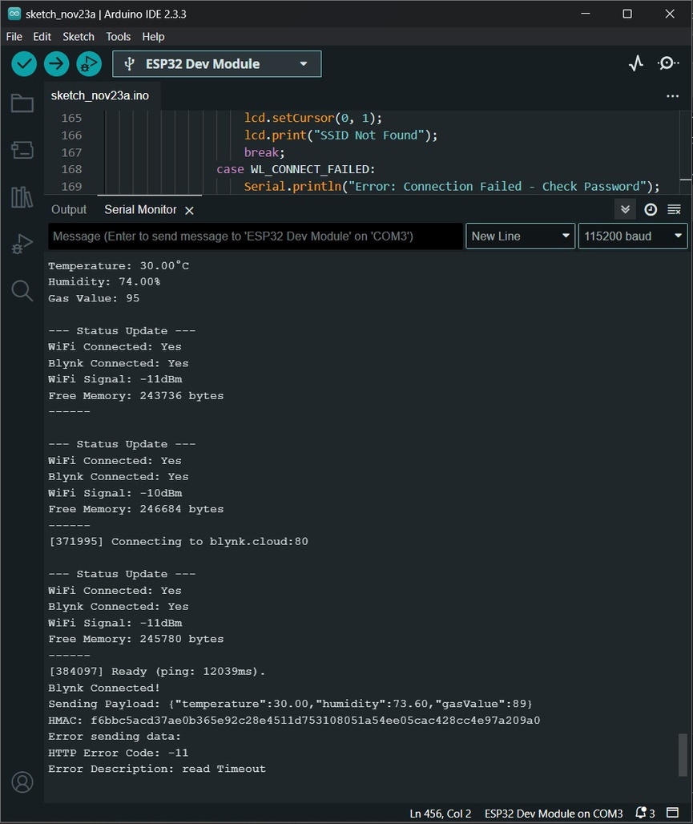
Experimental Results: 1) Serial Monitor:

Slide 11
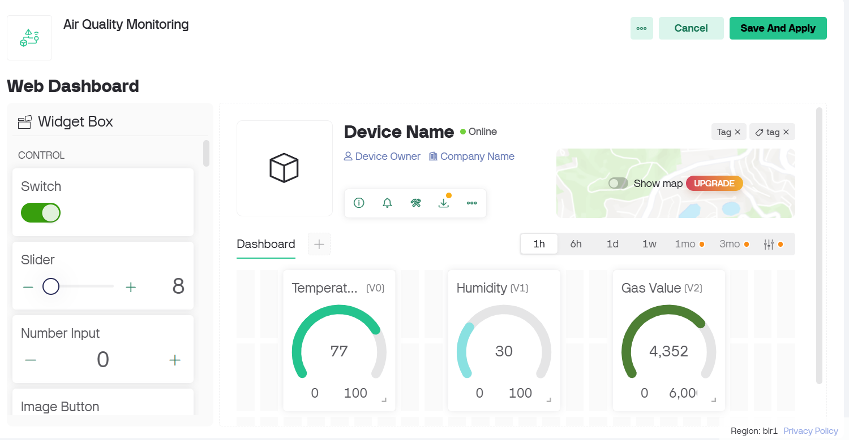
2) Blynk App:

Slide 12
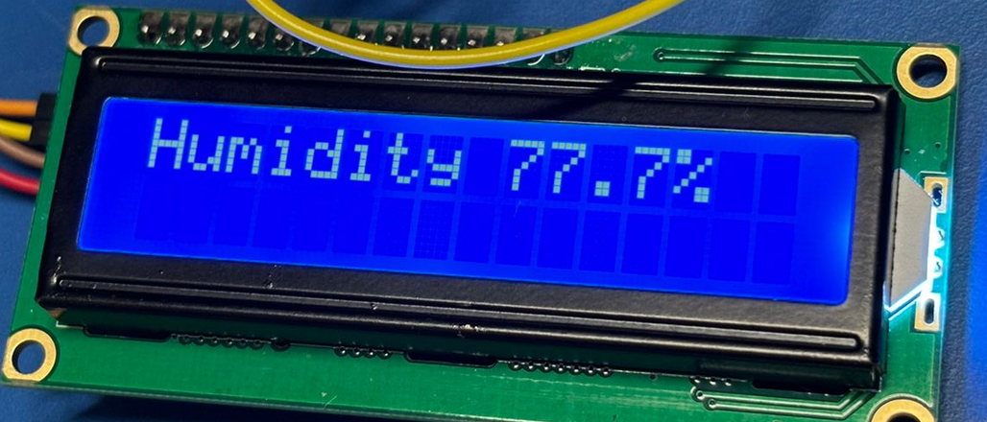
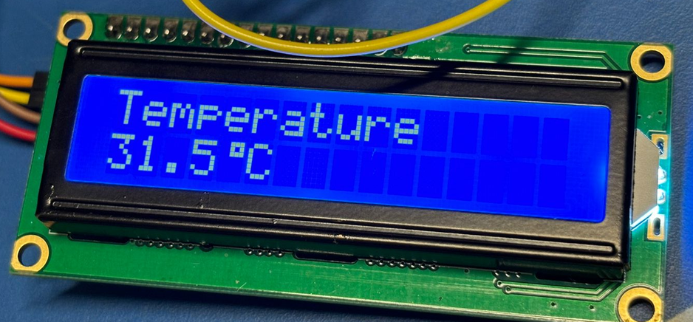
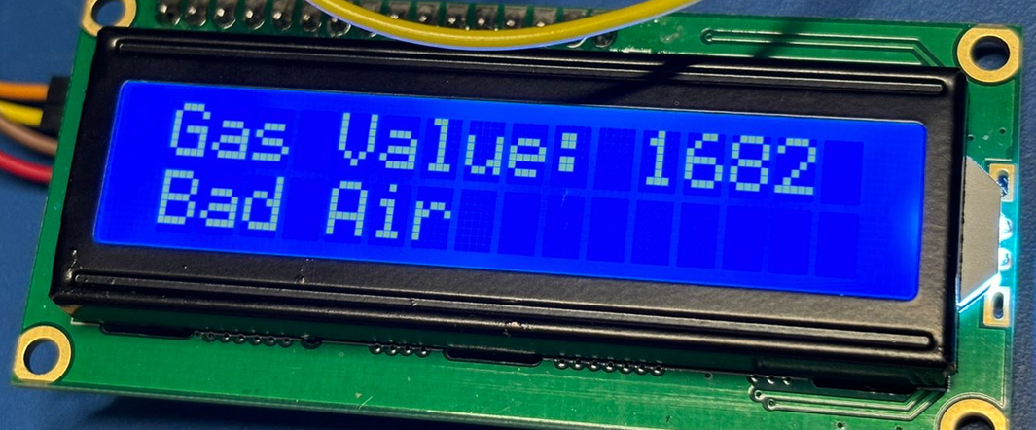
3) LCD Display:
Temperature
Humidity
Gas Value

Slide 13
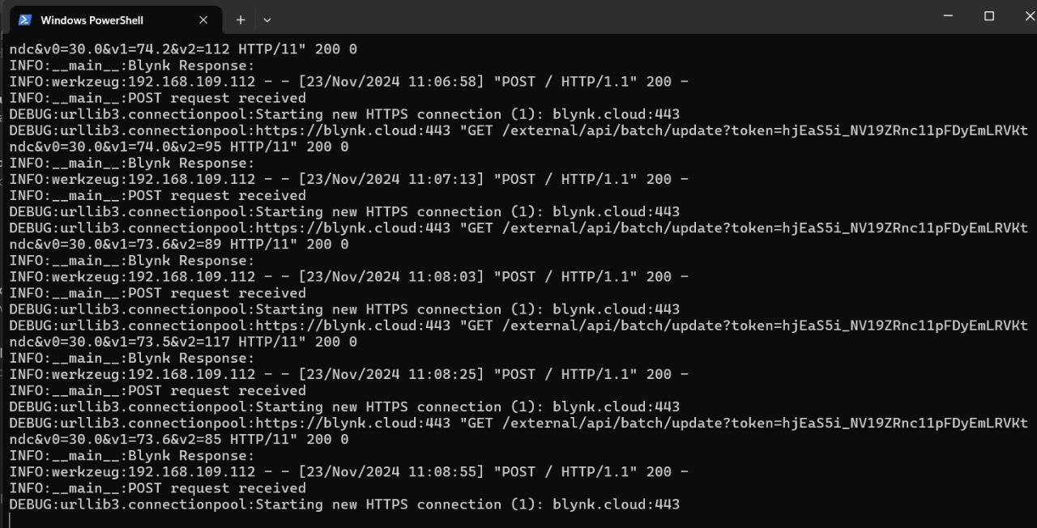
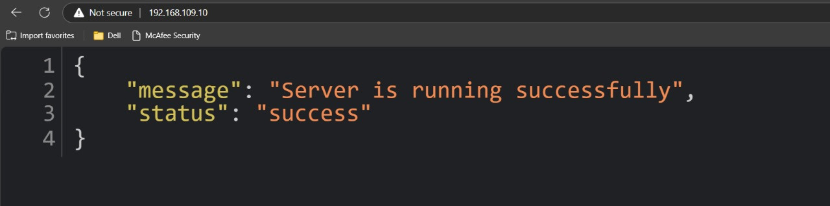
4) Server Side

Slide 14
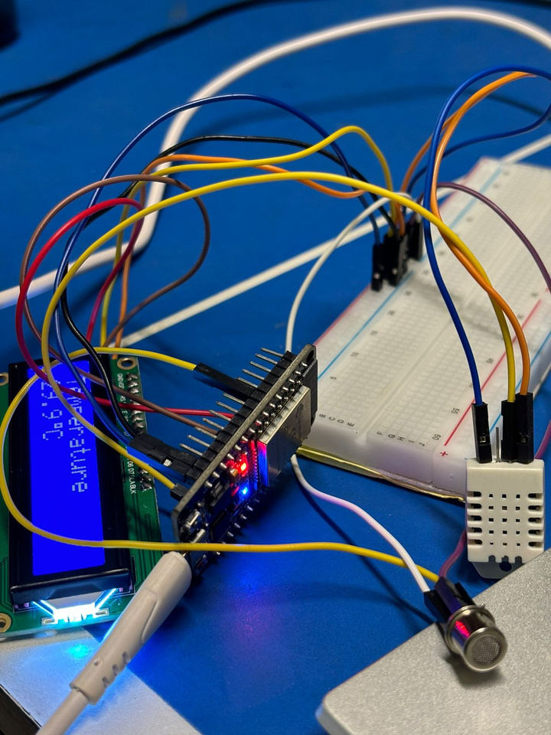
Circuit :

Slide 15

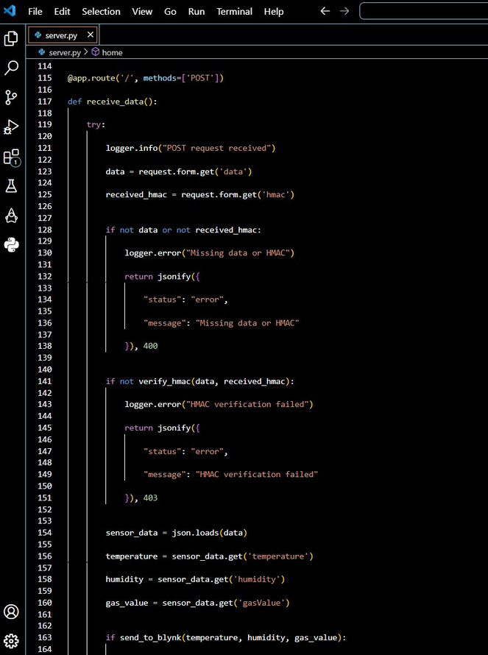
Demonstration
ino code
server code

Slide 16
Conclusion
The project developed a prototype to monitor and detect air quality in vehicle cabins to protect passenger health from harmful contaminants.
A Prototyping approach was used, involving stages such as communication, planning, quick design, prototype construction, and testing.
The system includes an air quality sensor, temperature and humidity sensor, carbon monoxide sensor, dust sensor, multiplexer, and microcontroller.
The Blynk app allows users to monitor air quality metrics easily by visualizing real-time data on smartphones.
Data integrity is ensured using HMAC SHA-256 authentication for secure communication between the sensors and the middleware server.
The system operates with an Arduino Uno, which connects to Blynk for real-time monitoring.
Testing showed that the prototype successfully detects and monitors air quality in real-time, achieving its intended purpose.

Slide 17
Thank you

